Slide 1
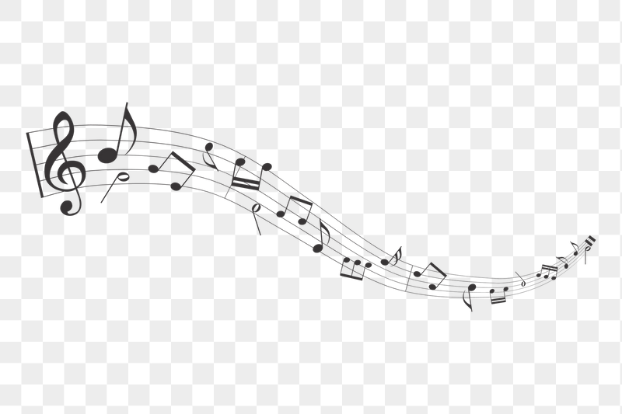
What Makes a Song Popular?
-Analysis of Music Popularity on Spotify
Jingyi Du (jd3882)
Jingyi Zhang (jz3543)
Jingyu Gu (jg4536)
Yuchen Wang (yw3890)
05.04.2023

Slide 2

Motivation:
Why is this song popular?
What are the most popular genres of music on Spotify, and how have they changed over time?
Are there any trends in the characteristics of popular songs, such as tempo or duration?
How to recommend songs based on user listening records?
Notes:
Find top music but the popularity music is not cater to my taste
Curious about the influence on music popularity

Slide 3

Dataset
the data source we are using for this project is “the Spotify data 1921 - 2020” dataset in kaggle database.
Url: https://www.kaggle.com/datasets/ektanegi/spotifydata-19212020
The dataset is from Spotify and it contains hit songs from each year from the year 1921 to year 2020.

Slide 4
Dataset
Factors | Explanation
Popularity | Popularity of the song. From 0 to 100. The more popular the music is, the closer the attribute value is to 100.
Acousticness | Acoustic music refers to the pure band performance version that is not processed by electronic sound effects. The closer the music is to the original sound, the closer the attribute value is to 1.0.
Danceability | Danceability describes how danceable a track is in terms of a combination of musical elements.
Duration | Track duration in milliseconds.
Energy | Energy refers to a perceived measure of intensity and activity.
Explicit | Many artists use profanity in their music. This is a situation where music should be labeled as explicit.
Instrumentalness | Instrumentalness refers to whether a track contains no vocals. The fewer vocals the music contains, the closer the attribute value is to 1.0.
key | The estimated pitch of the song.
Liveness | A higher liveness value indicates an increased likelihood that the piece will be played live.
Loudness | The overall loudness of the composition in decibels (dB).
Mode | “Any of several ways of ordering the notes of a scale according to the intervals they form with the tonic, thus providing a theoretical framework for the melody.”
Speechiness | Speechiness detects the presence of spoken words in a track. The more the recording resembles speech (such as an audiobook), the closer the attribute value is to 1.0.
Tempo | The overall estimated tempo of the track in beats per minute (BPM).
Valence | Valence is used to describe the musical positivity conveyed by a track.
For each row, it contains the popularity of each song and its 13 characteristics.
The closer the score is to 1, the stronger this feature is.
Notes:
Features 程度的0-1
Features 有实际意义的有自己的衡量单位

Slide 5
Dataset
Factors | Explanation
Popularity | Popularity of the song. From 0 to 100. The more popular the music is, the closer the attribute value is to 100.
Acousticness | Acoustic music refers to the pure band performance version that is not processed by electronic sound effects. The closer the music is to the original sound, the closer the attribute value is to 1.0.
Danceability | Danceability describes how danceable a track is in terms of a combination of musical elements.
Duration | Track duration in milliseconds.
Energy | Energy refers to a perceived measure of intensity and activity.
Explicit | Many artists use profanity in their music. This is a situation where music should be labeled as explicit.
Instrumentalness | Instrumentalness refers to whether a track contains no vocals. The fewer vocals the music contains, the closer the attribute value is to 1.0.
key | The estimated pitch of the song.
Liveness | A higher liveness value indicates an increased likelihood that the piece will be played live.
Loudness | The overall loudness of the composition in decibels (dB).
Mode | “Any of several ways of ordering the notes of a scale according to the intervals they form with the tonic, thus providing a theoretical framework for the melody.”
Speechiness | Speechiness detects the presence of spoken words in a track. The more the recording resembles speech (such as an audiobook), the closer the attribute value is to 1.0.
Tempo | The overall estimated tempo of the track in beats per minute (BPM).
Valence | Valence is used to describe the musical positivity conveyed by a track.
Categorical Features:
Mode, Explicit, Key
Numerical Features:
Acousticness, Danceability,
Duration_ms, Energy,
Instrumentalness, Liveness,
Loudness, Popularity,
Speechiness,
Tempo, Valence, Year
Notes:
Acousticness, Explicit, Valence可以解释一下

Slide 6
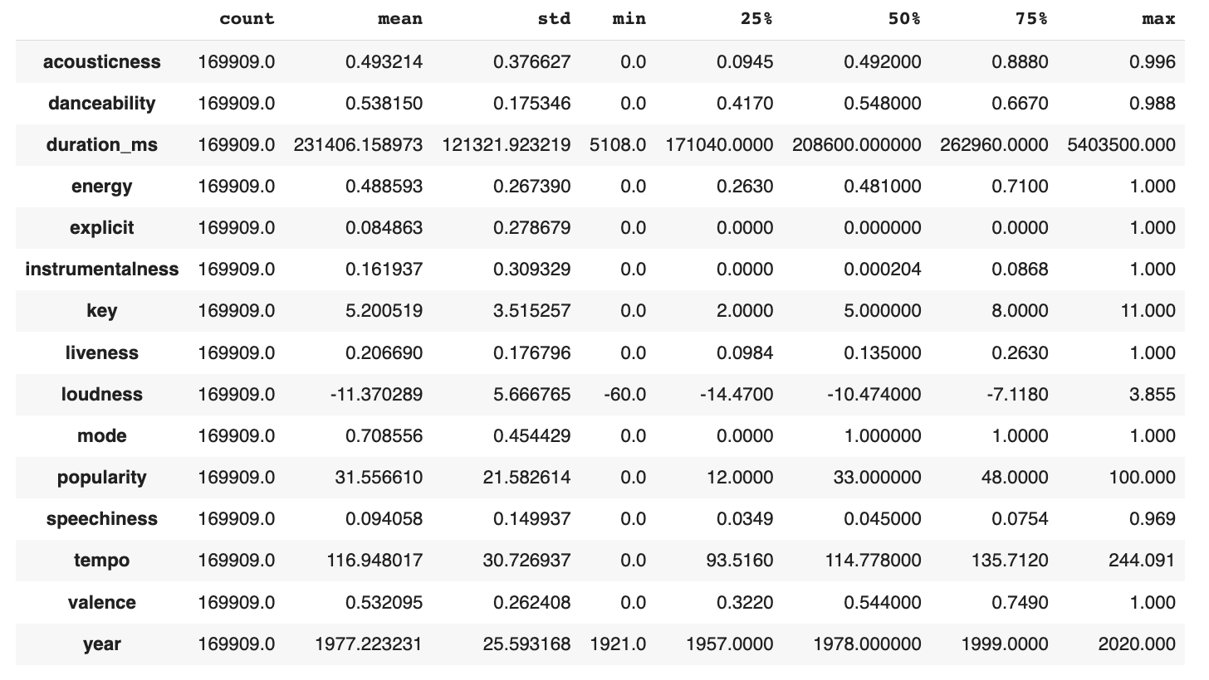
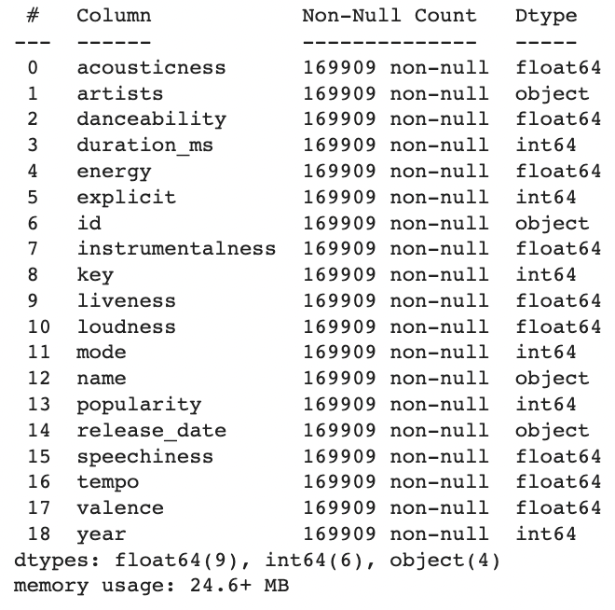
Dataset Information
Statistics Summary
Dataset Size & Types

Slide 7
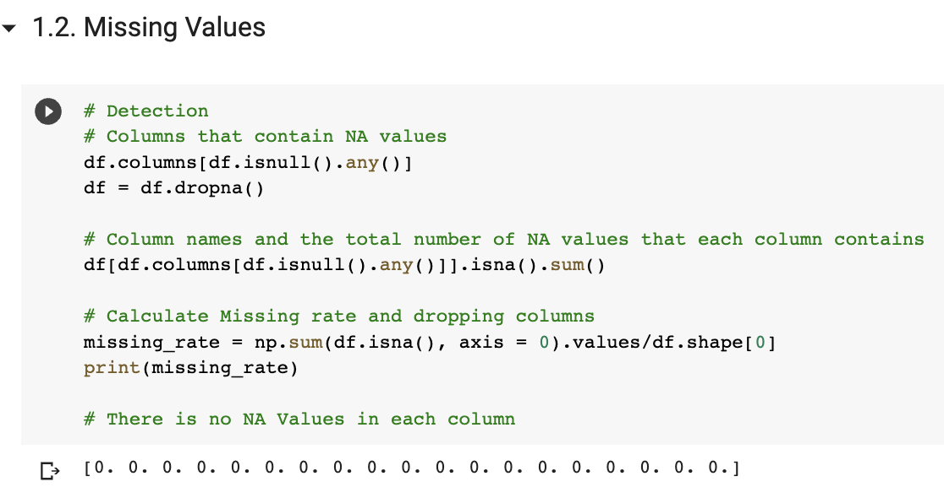
Data Cleaning
We dropped all NA values

Slide 8
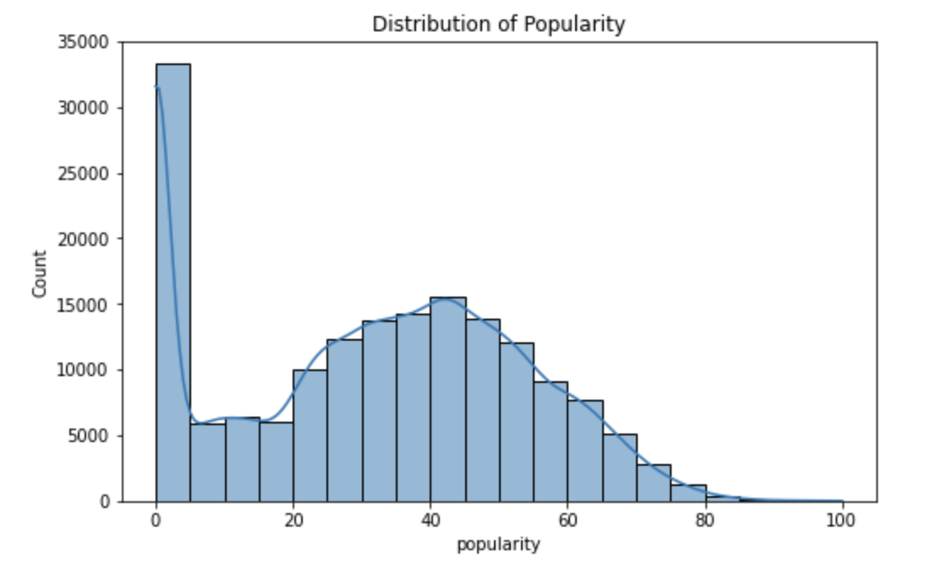
Data Visualization: Dependent Variable
The Distribution of Popularity
Insights:
A majority songs have the popularity equal to 0 due to their early release year
Without considering about songs with a popularity 0, the distribution of popularity looks like normal distribution
There are no so much extremely popular songs or extremely not popular songs
Mean = 31.56, Median=33.00, Standard Deviation = 21.58
Notes:
1，大部分在0，年份特别靠前的很老的歌是0，老歌
2，30-50，大部分的歌是比较中庸的，很popularity的歌其实不是很多

Slide 9
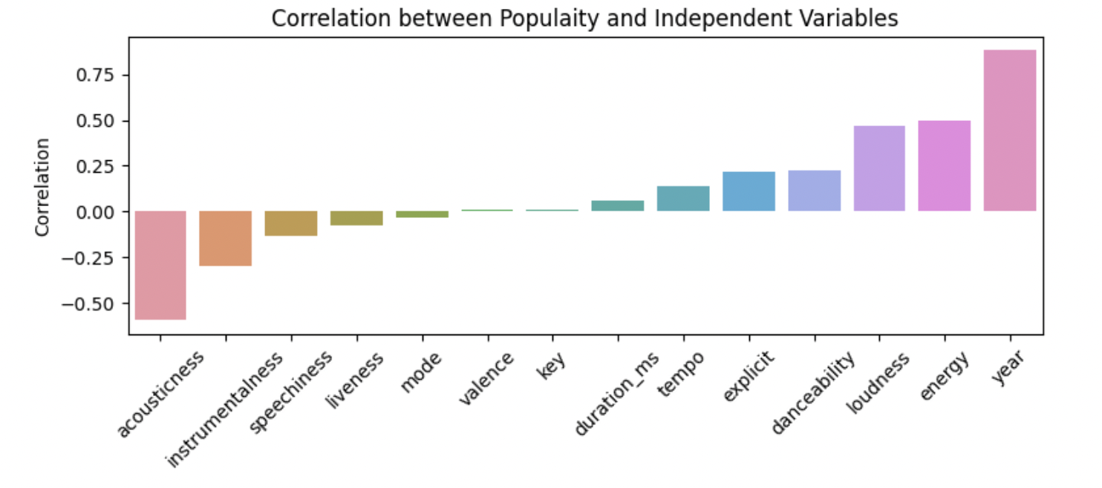
Data Visualization: Dependent Variable
The Correlation between Popularity and Independent Variables
Year influences the popularity of songs most positively
Acousticness influences the popularity of songs most negatively

Slide 10
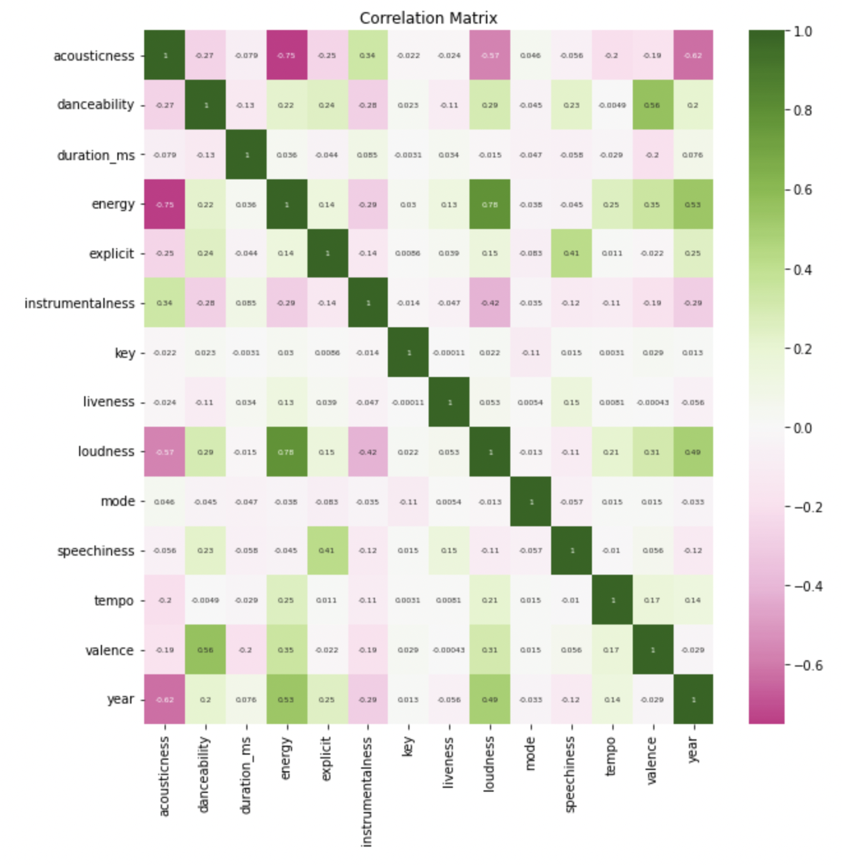
Data Visualization: Independent Variables
The Correlation between Independent Variables
Test the collinearity
No high-correlated features

Slide 11
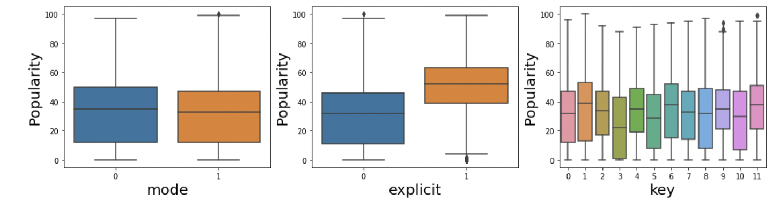
Data Visualization: Independent Variables
The Boxplots of Categorical Features
The influence of categorical features on songs’ popularity
Notes:
explicit对popularity的影响很大，dummy的影响

Slide 12
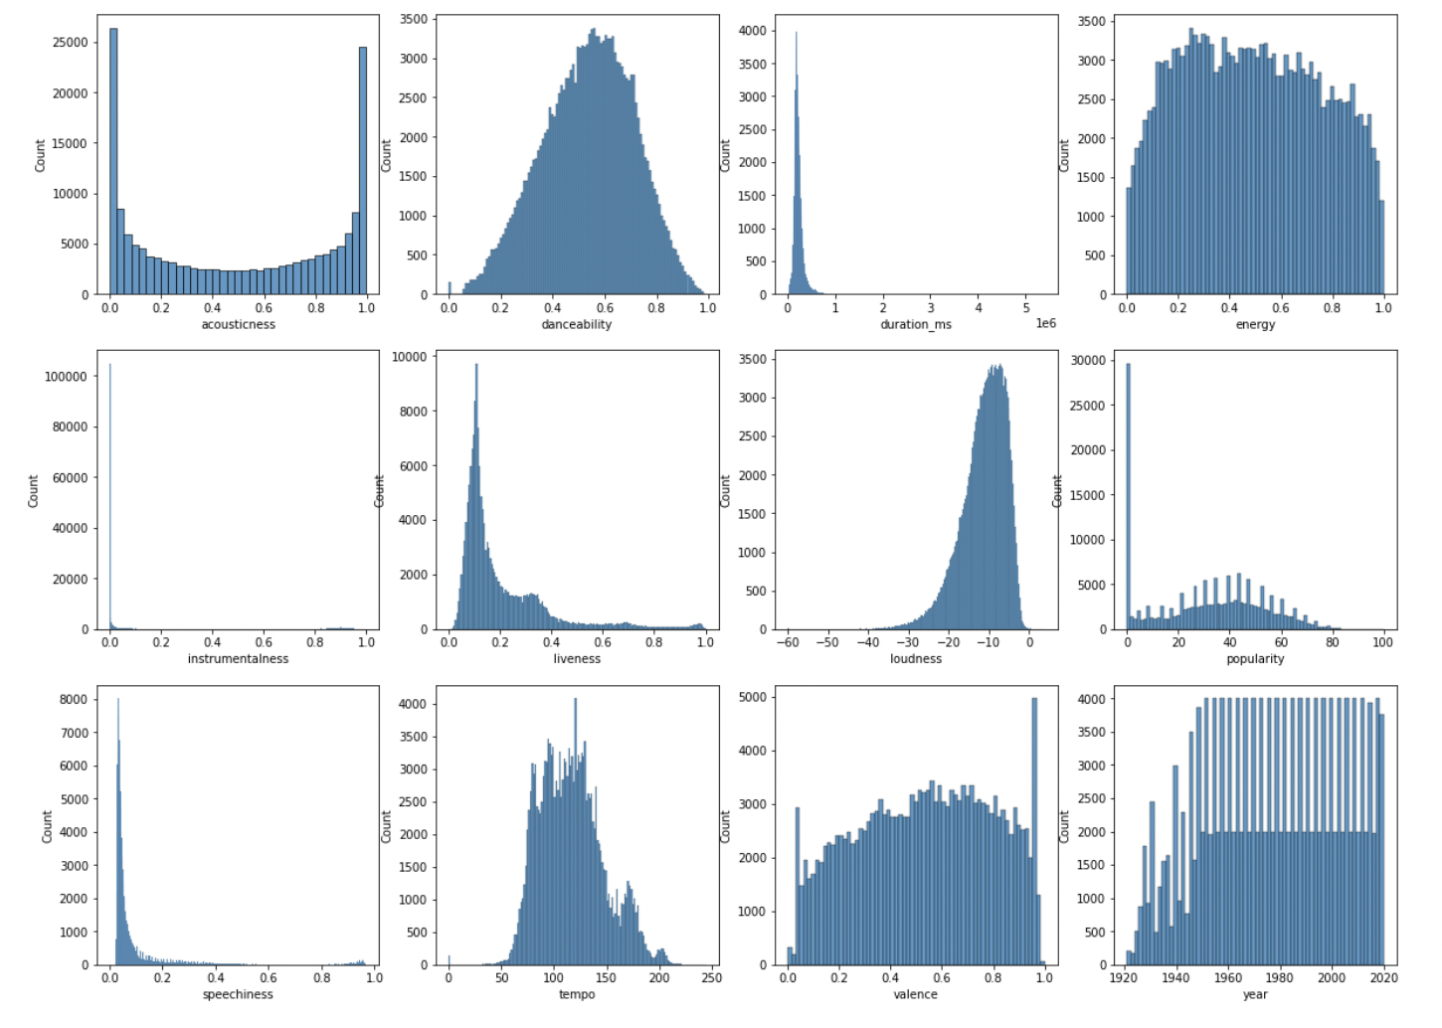
Data Visualization: Independent Variables
The Histograms of Numerical Features
Distributions of each numerical features

Slide 13
Machine Learning Preprocessing
Categorical Features Encoding
Ordinal Encoding for “key”
One-Hot Encoding for mode and explicit which are dummy variables
Scaling:
StandardScaler()
Train test 0.8/0.2 split.
Scaling for X_train and X_test

Slide 14
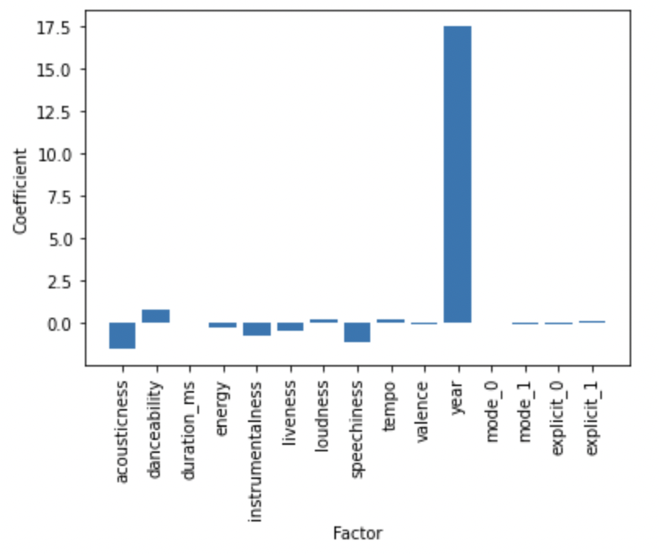
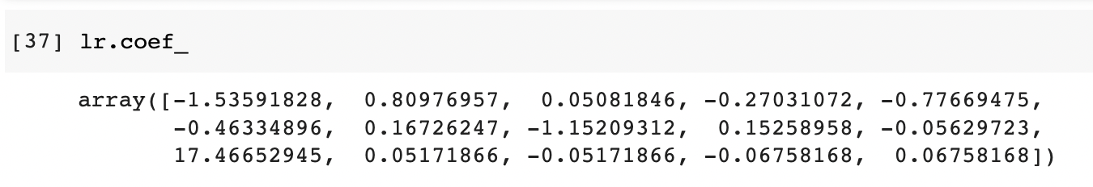
Machine Learning: Linear Regression
Feature Importance of Linear Regression
Linear Regression:
Score of Linear Regression on the test set is score = 0.7855
MSE: 100.69
The newer the song is, the higher popularity it will have
Notes:
year的影响大

Slide 15
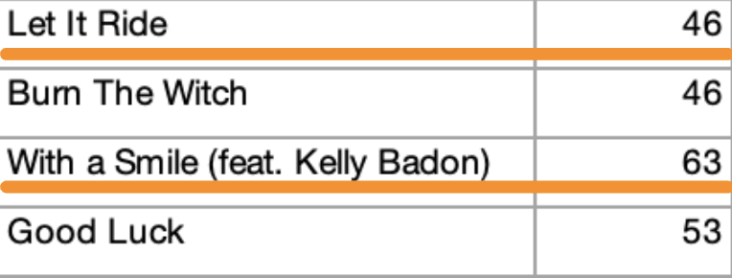
Machine Learning: Decision Tree
Decision Tree Classifier:
Set popularity score of 55 as the criterion for judging whether the song is popular or not popular
E.g., the song “Let It Ride” with the popularity score of 46 is an NP (not popular) and the song “With a Smile” with popularity scope of 63 is a PO (popular).
Notes:
set了一个标准，来区分songs是不是popular的，分类标准

Slide 16
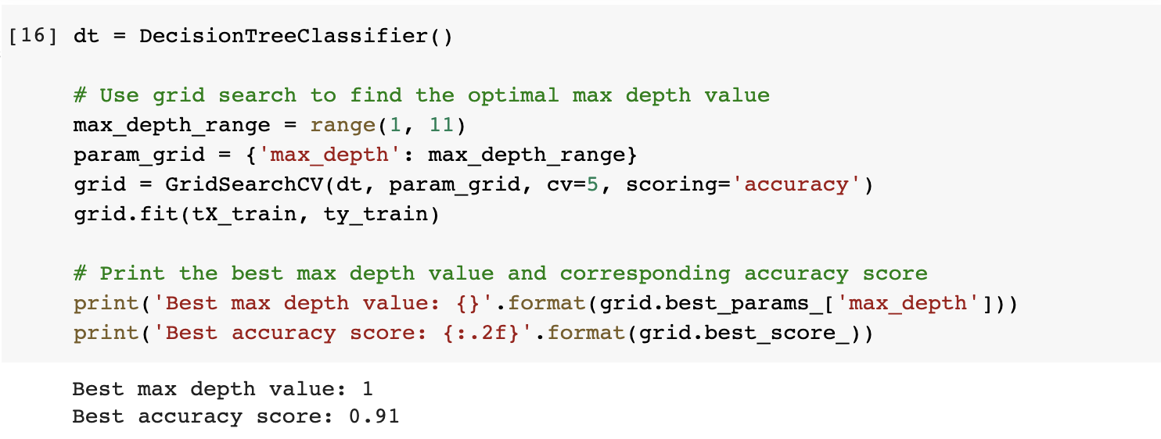
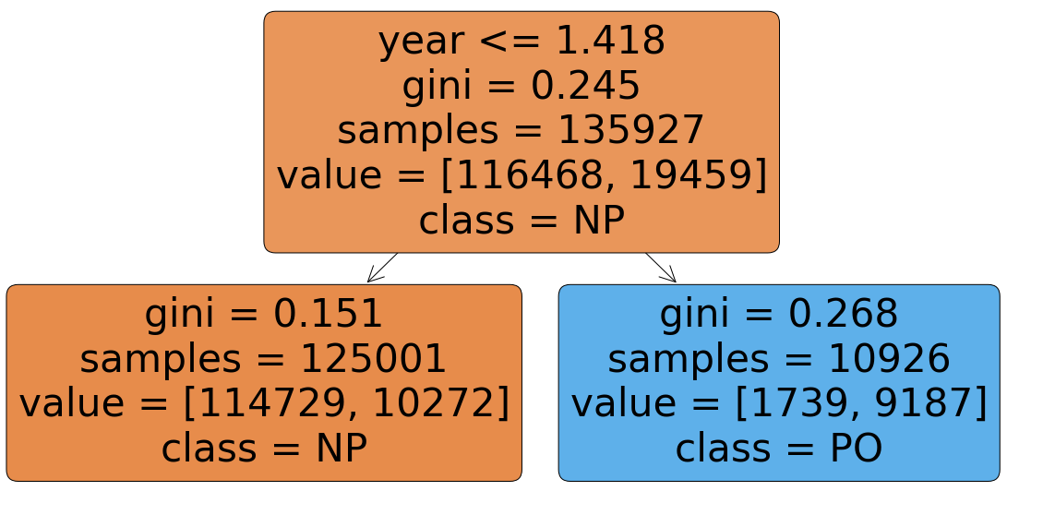
Machine Learning: Decision Tree
Hyperparameter Tuning and Best Model Selection
Insights:
Max_depth =1, tree only consider “year” as the criterion for classification
The attribute “year” has too strong influence.
To get deeper tree, we need to drop it.
Notes:
没有去掉year的时候发现，year的权重太大了influence太strong了，我们希望看到deepertree以及其他因素的影响，所以后面把yeardrop掉了

Slide 17
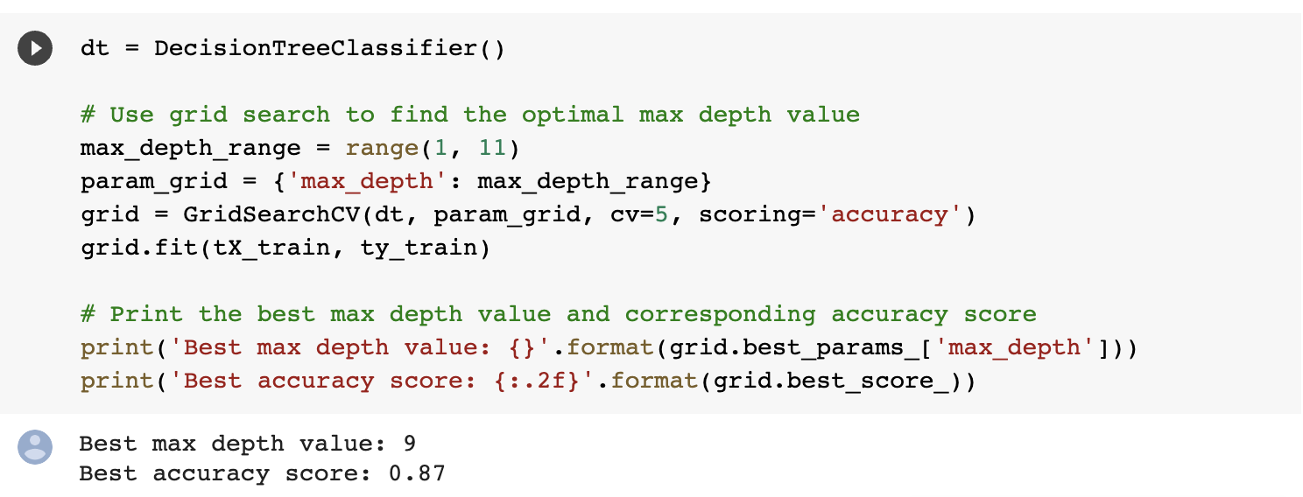
Machine Learning: Decision Tree
Hyperparameter Tuning and Best Model Selection
Model Performance:
The best max depth=9
Model accuracy=0.87
Insights:
After dropping “year”, we achieve a deeper tree which take more features into consideration
Avoid Over-fitting on a specific dataset

Slide 18
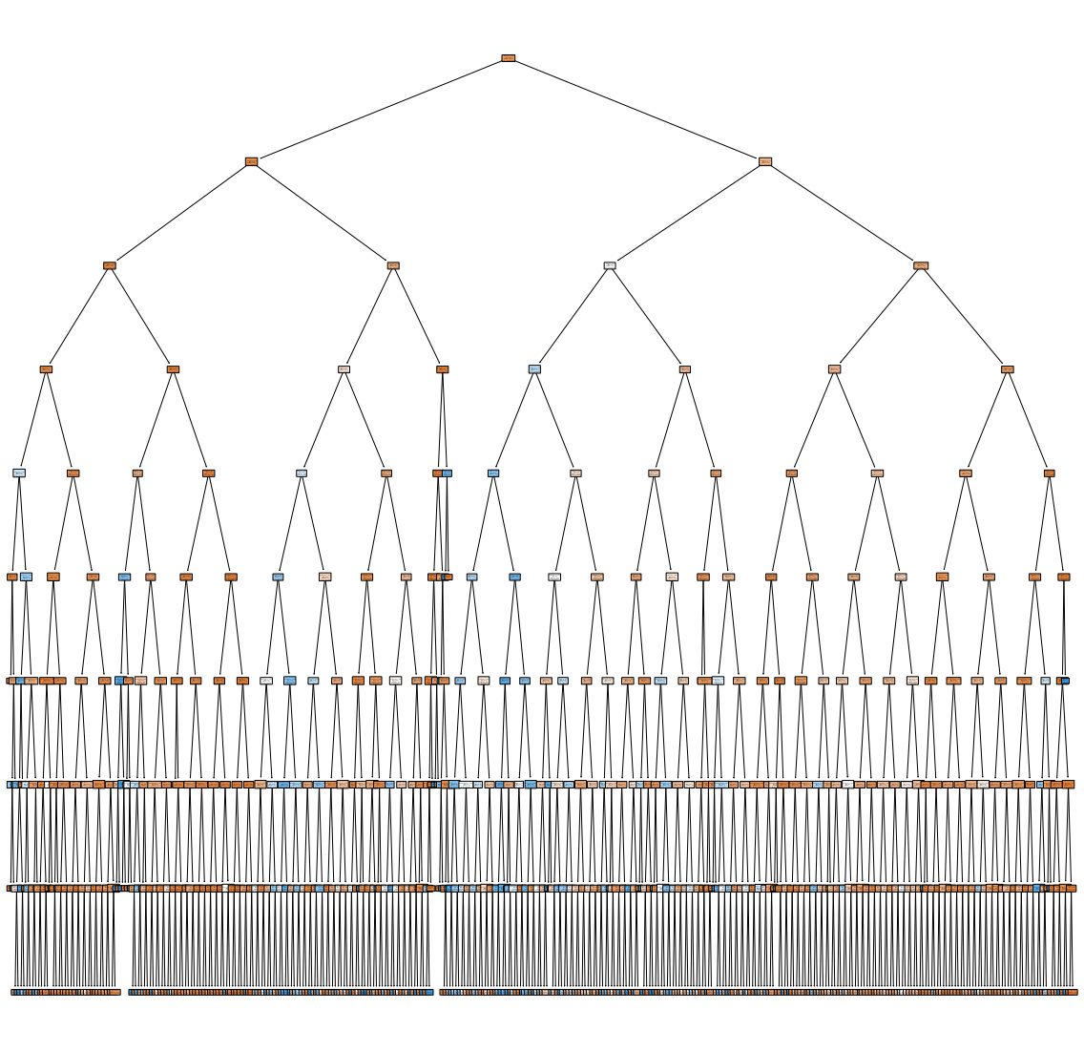
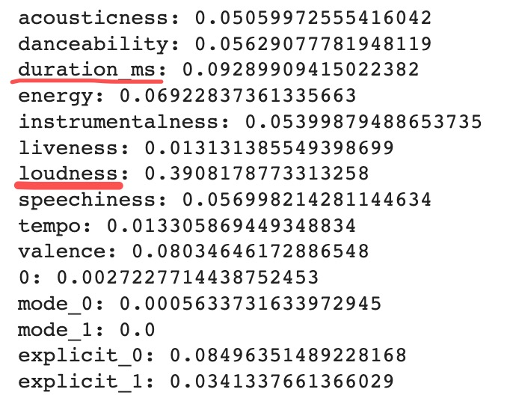
Machine Learning: Decision Tree
Feature Importance Evaluation - Top 3
Year;
Loudness;
Duration of the song.
Notes:
发现人们对音乐的音量和长度其实还挺在意的

Slide 19
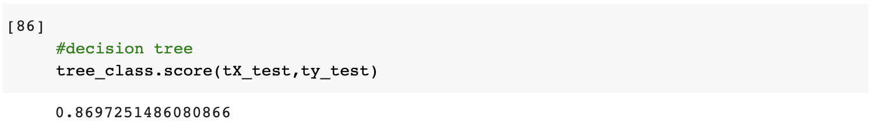
Machine Learning: Decision Tree
Model Performance on test set
R^2 - Decision Tree Classifier

Slide 20
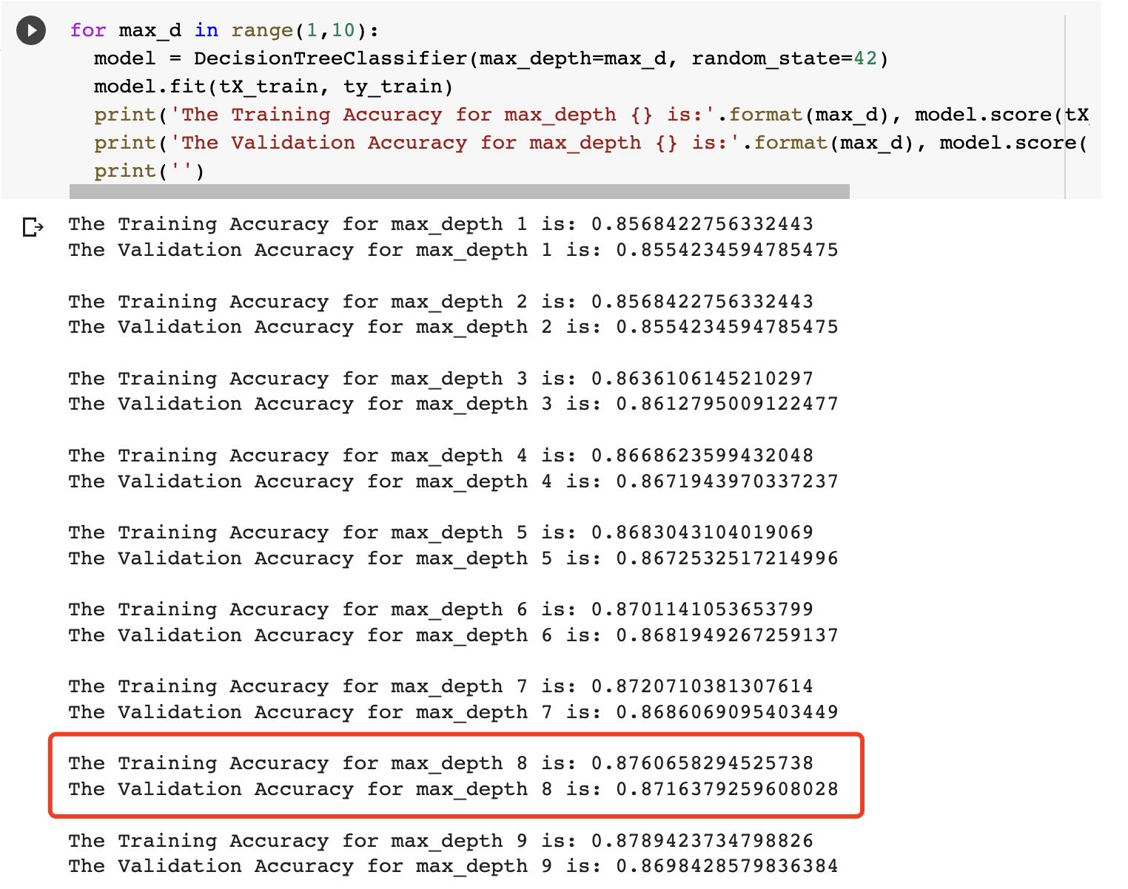
Machine Learning: Decision Tree
Decision Tree Regressor:
Model Performance:
The best max depth=8
Model R^2 =0.87
We select the best model with the maximum validation accuracy
Notes:
We used popularity score dericively

Slide 21
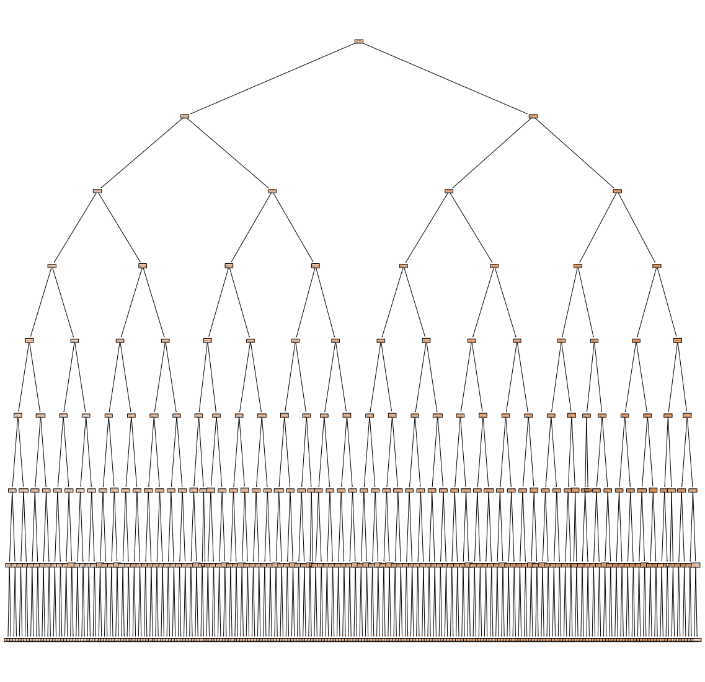
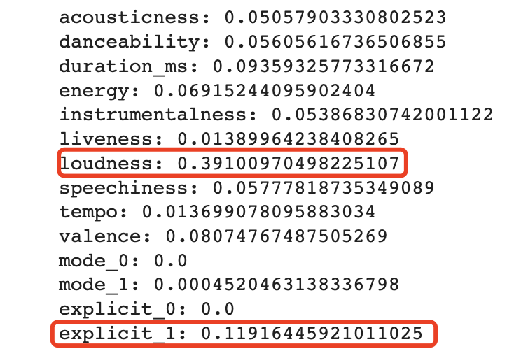
Machine Learning: Decision Tree
Feature Importance Evaluation - Top 3
Year;
Loudness;
Explicit.

Slide 22
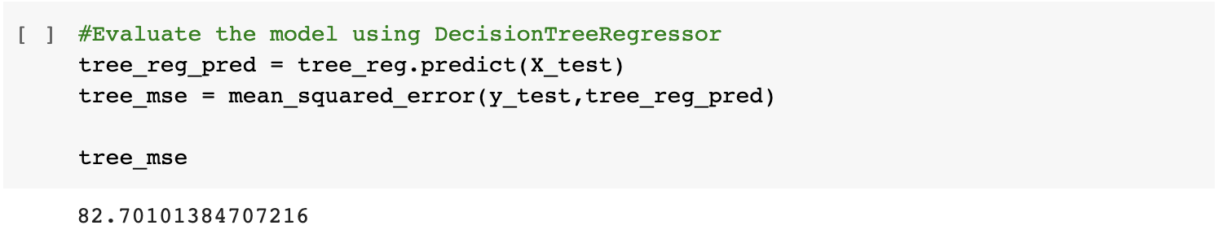
Machine Learning: Decision Tree
Model Performance on test set
R^2 - Decision Tree Regressor
R^2
MSE - Decision Tree Regressor
MSE

Slide 23
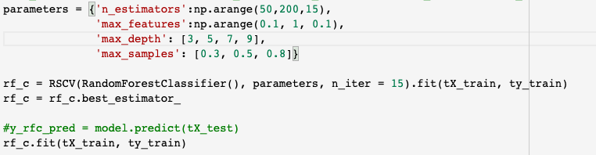
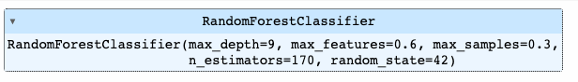
Machine Learning: Random Forest
Random Forest Classifier
Find the best estimator using cross-validation
Max_depth = 9, max_feature = 0.6, max_samples=0.3, n_estimators = 170
Notes:
Year random model

Slide 24
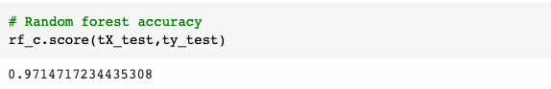
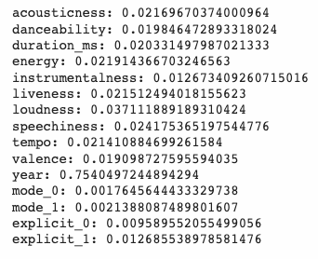
Machine Learning: Random Forest
Model Performance - Random Forest Classifier
Accuracy: 0.97
Feature Importance - Top 5
Year
Loudness
Speechiness
Energy
Acousticness

Slide 25
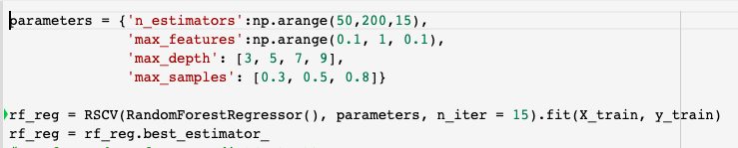
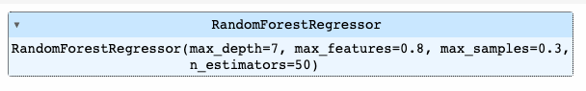
Machine Learning: Random Forest
Random Forest Regressor
Find the best estimator using cross-validation
Max_depth = 7, max_feature = 0.8, max_samples=0.3, n_estimators = 50

Slide 26
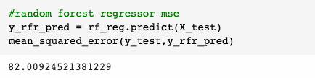
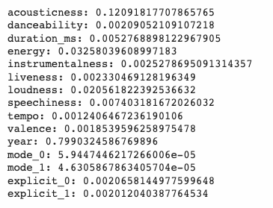
Machine Learning: Random Forest
Model Performance - Random Forest Regressor
MSE: 82.00
Feature Importance - Top 5
Year
Acousticness
Energy
Loudness
Speechiness

Slide 27
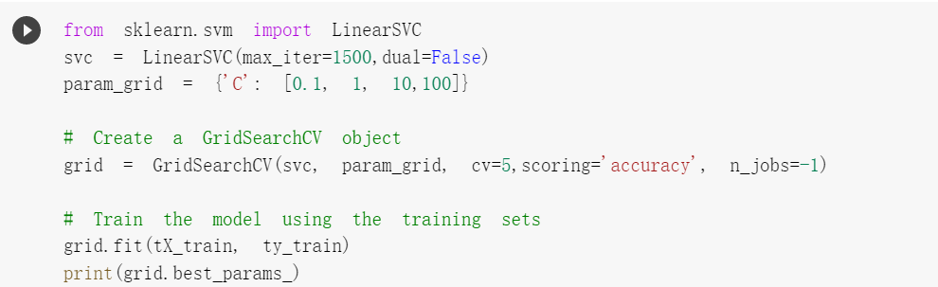
Machine Learning: SVM
Support Vector Machine Classifier
Hyperparameter Tuning
Find the best regularization parameter C using cross-validation
Best parameter is 0.1.

Slide 28
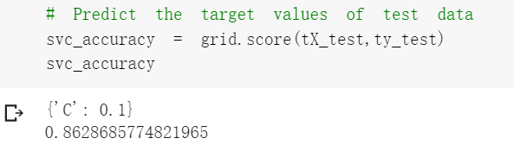
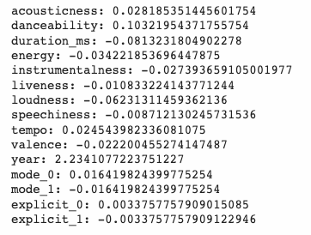
Machine Learning: SVM
Model Performance - SVC
Accuracy: 0.86
lower than decision tree(0.8697)
and random forest(0.9715)
So it is not a good method.
Feature Importance - Top 3
Year
Danceability
Acousticness

Slide 29
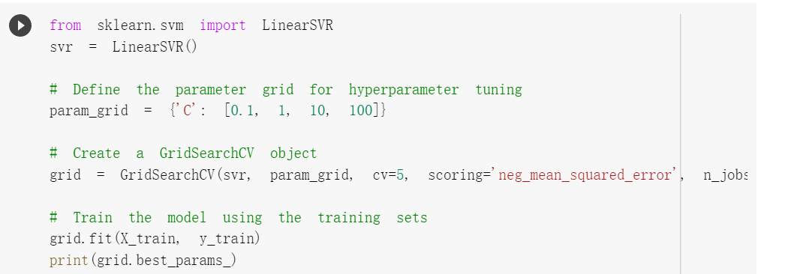
Machine Learning: SVM
Support Vector Machine Regression
Hyperparameter Tuning
Find the best regularization parameter C using CV
Best parameter is 10

Slide 30
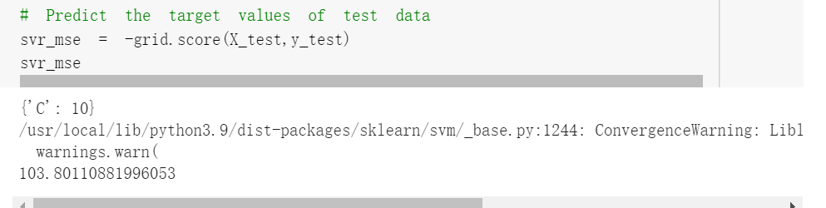
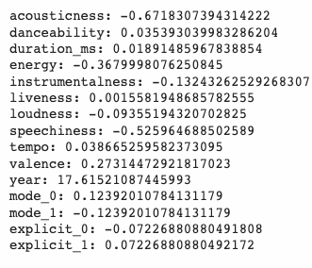
Machine Learning: SVM
Model Performance - SVR
MSE: 103.8
Feature Importance - Top 3
Year
Acousticness
Speechiness

Slide 31
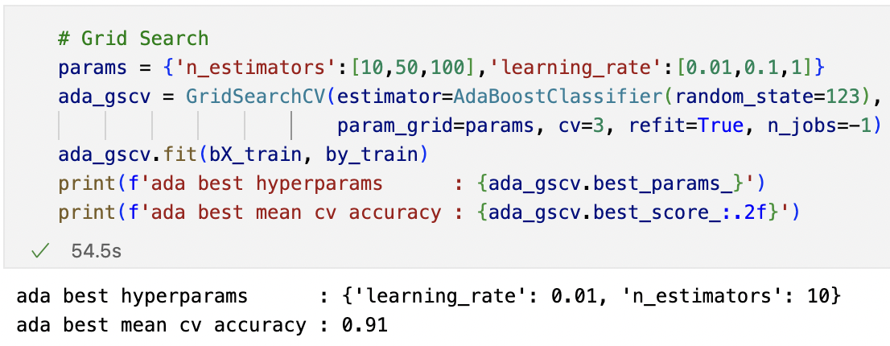
Machine Learning: Adaboost
Adaboost Classifier
Hyperparameter Tuning and Best Model Selection
Model Performance:
The best learning rate = 0.01
The optimal n estimators = 10
Best Model Performance:
Training score: 0.9116
Testing score: 0.9101
Here we use the training set containing “year” feature to train the Adaboost Classifier
We know that feature “year” will influence the model too much, so when considering about feature importance, we train two Adaboost models with/without feature “year” later

Slide 32
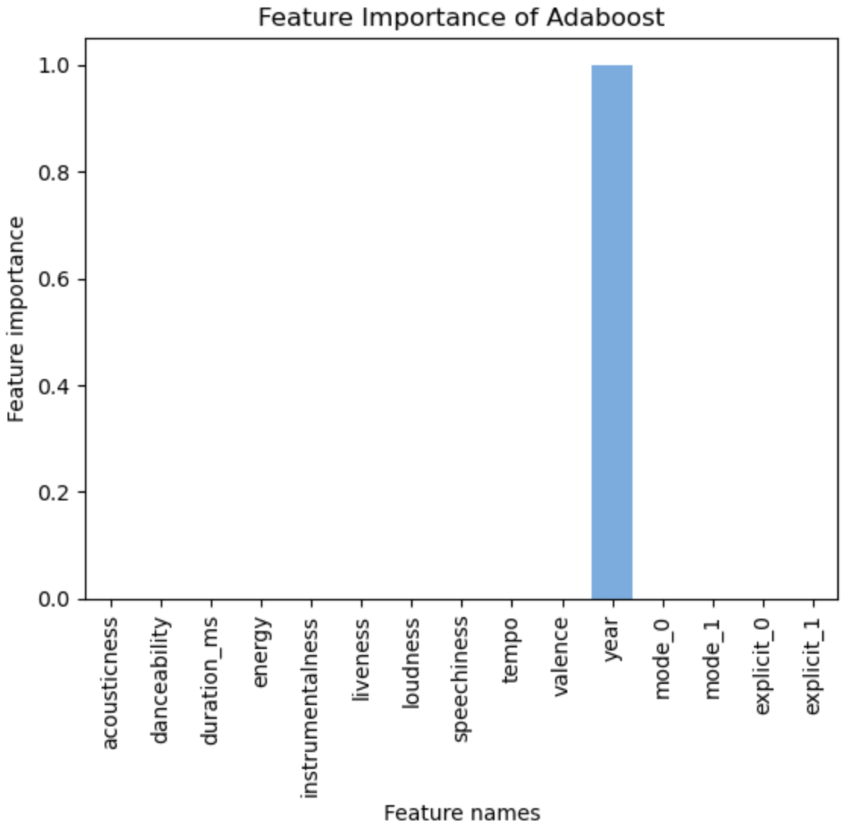
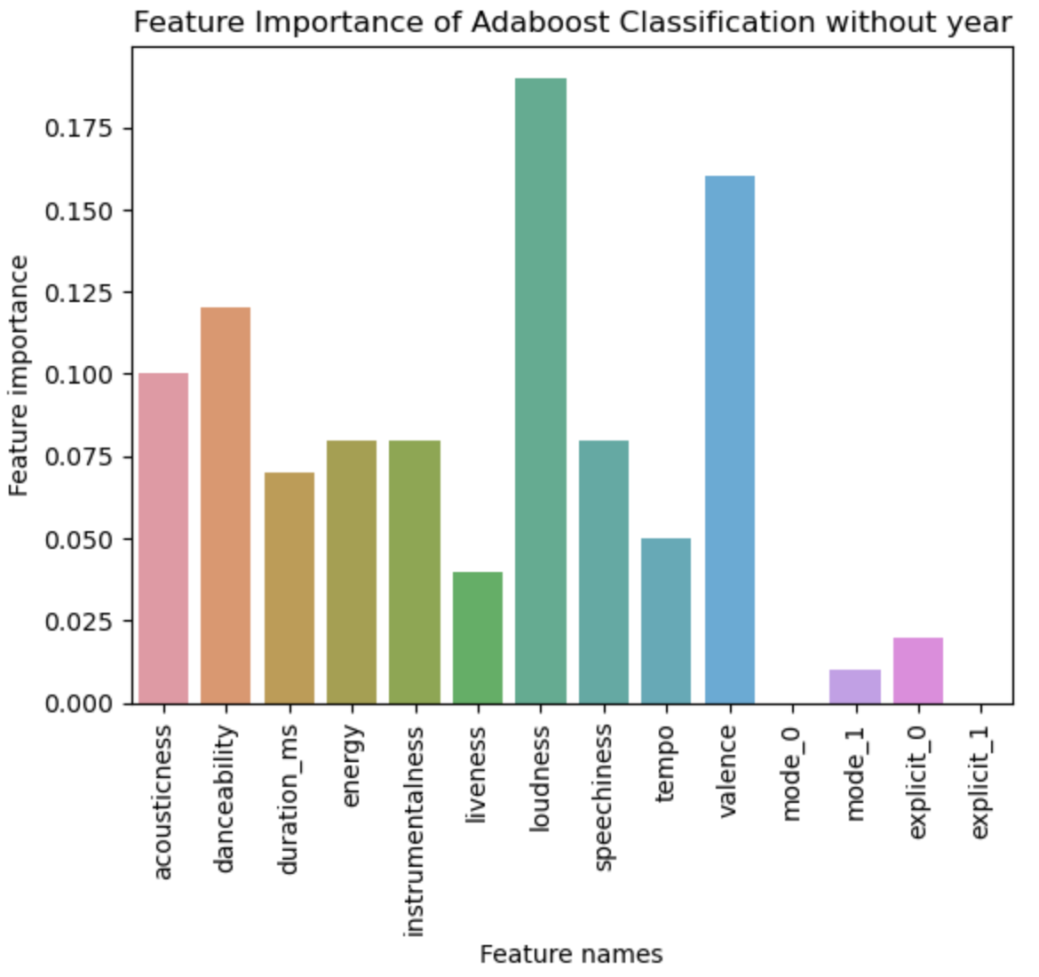
Machine Learning: Adaboost
Adaboost Classifier - Feature Importance
Top 5 Features:
('year', 1.0),
('acousticness', 0.0),
('danceability', 0.0),
('duration_ms', 0.0),
('energy', 0.0)
Top 5 Features:
('loudness', 0.19),
('valence', 0.16),
('danceability', 0.12),
('acousticness', 0.1),
('energy', 0.08)

Slide 33
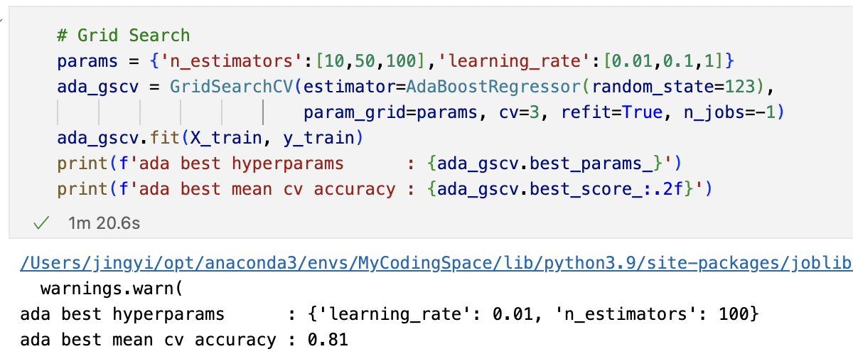
Machine Learning: Adaboost
Adaboost Regressor
Hyperparameter Tuning and Best Model Selection
Model Performance:
The best learning rate = 0.01
The optimal n estimators = 100
Best Model Performance:
Training score: 0.8092
MSE: 88.5075

Slide 34
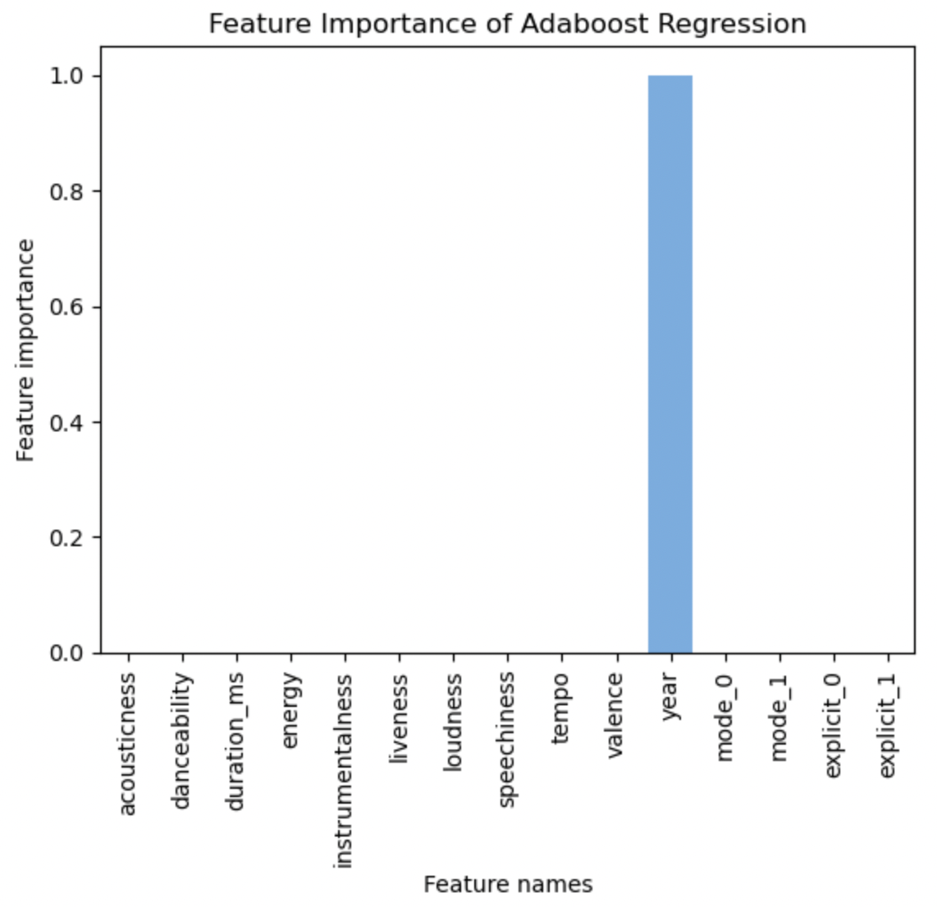
Machine Learning: Adaboost
Adaboost Regressor - Feature Importance
Feature Importances:
('year', 0.999911475733514),
('instrumentalness',8.8524e-05),
('acousticness', 0.0),
('danceability', 0.0),
('duration_ms', 0.0),
('energy', 0.0),
('liveness', 0.0)
('loudness', 0.0),
('speechiness', 0.0),
('tempo', 0.0),
('valence', 0.0),
('mode_0', 0.0),
('mode_1', 0.0),
('explicit_0', 0.0),
('explicit_1', 0.0)
Insights:
The releasing day of songs influence the popularity of songs significantly comparing with others attributes

Slide 35
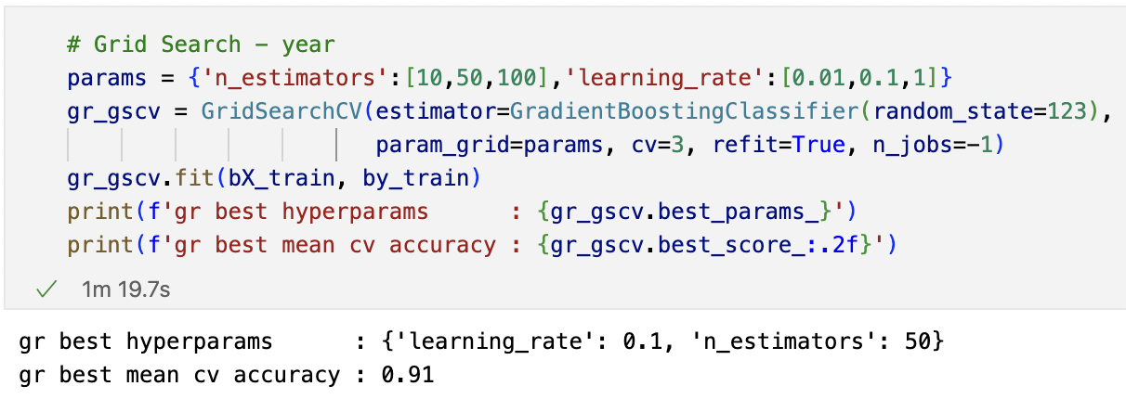
Machine Learning: Gradient Boost
Gradient Boost Classifier
Hyperparameter Tuning and Best Model Selection
Model Performance:
The best learning rate = 0.1
The optimal n estimators = 50
Best Model Performance:
Training score: 0.9121
Testing score: 0.9109
Here we use the training set containing “year” feature to train the Gradient Boost Classifier
We know that feature “year” will influence the model too much, so when considering about feature importance, we train two Gradient Boost models with/without feature “year” later

Slide 36
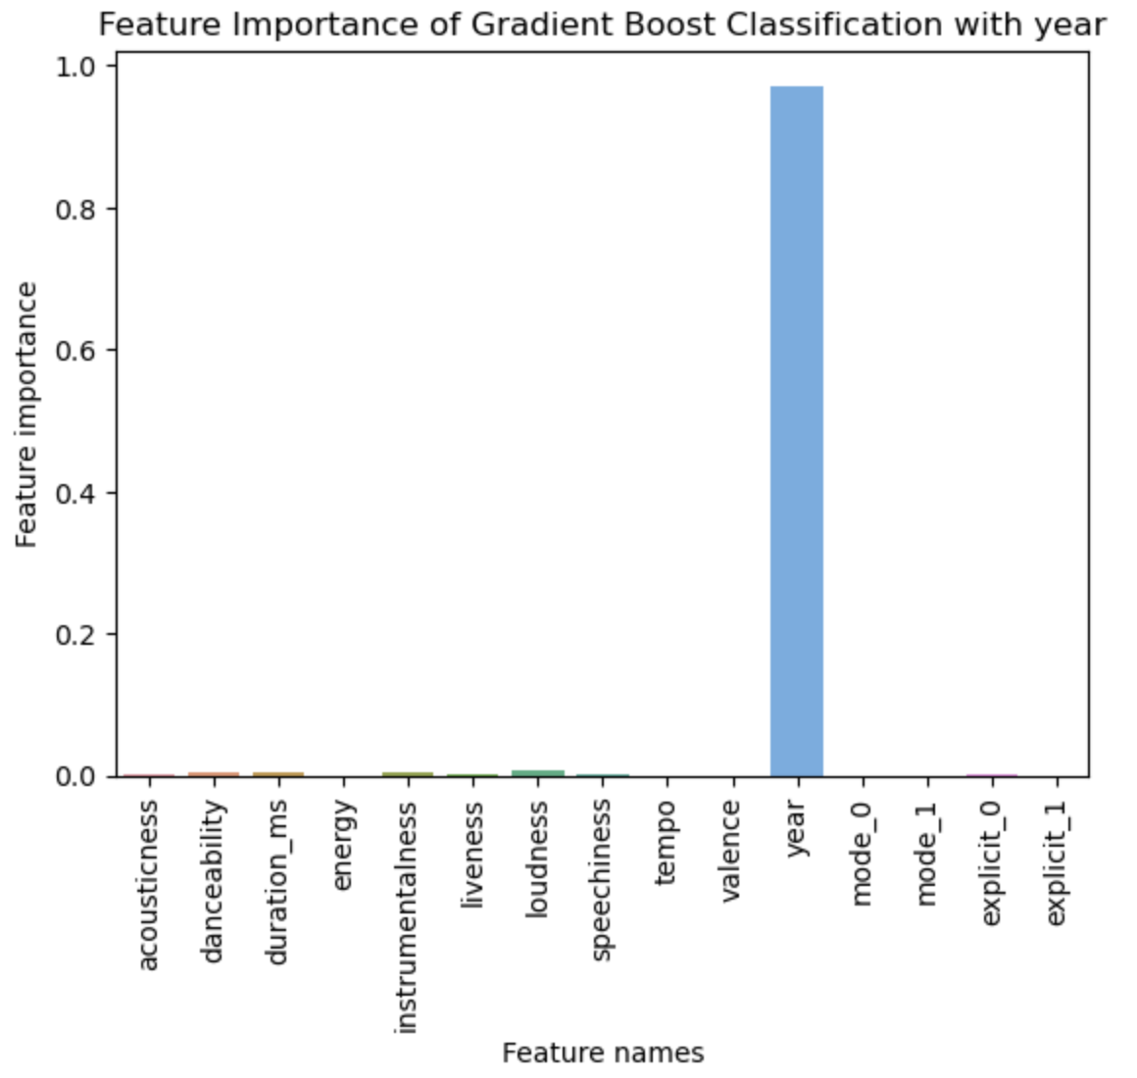
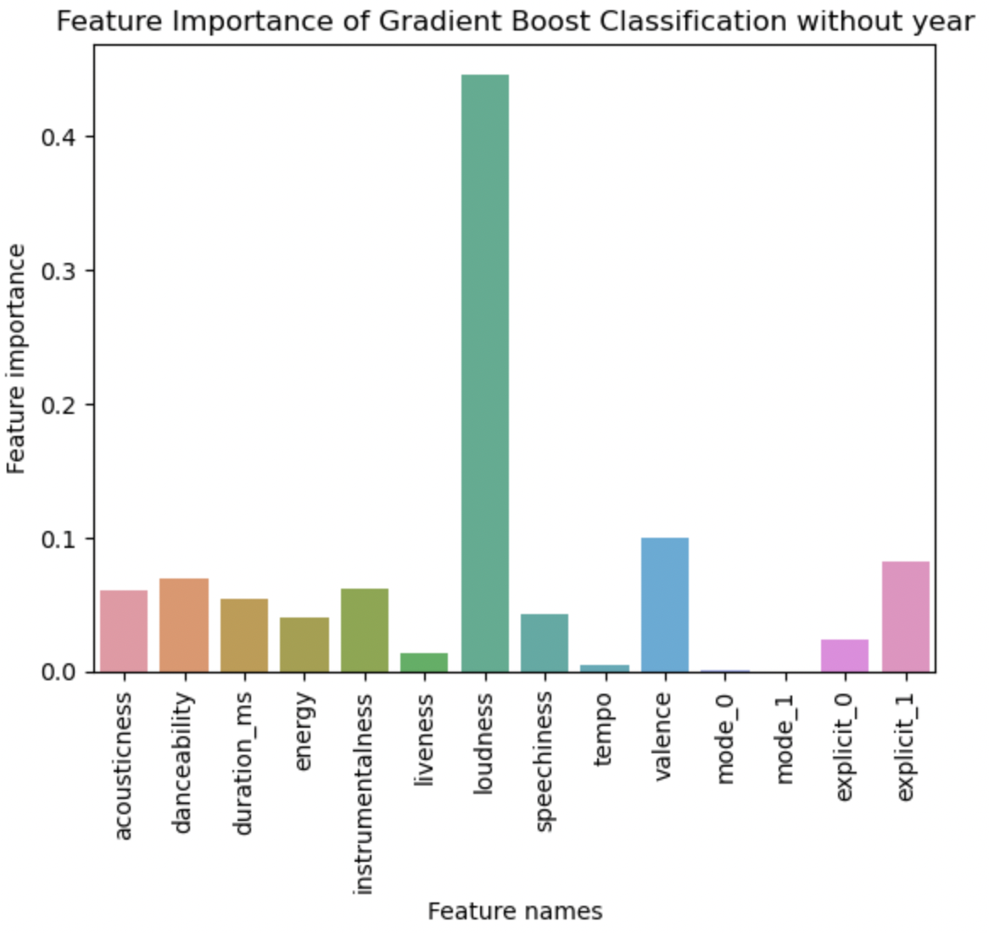
Machine Learning: Gradient Boost
Gradient Boost Classifier - Feature Importance
Top 5 Features:
('year', 0.975),
('loudness', 0.0080),
('duration_ms', 0.0055),
('instrumentalness', 0.0039),
('danceability', 0.0036)
Top 5 Features:
('loudness', 0.4465),
('valence', 0.0993),
('explicit_1', 0.0825),
('danceability', 0.0688),
('instrumentalness', 0.0612)

Slide 37
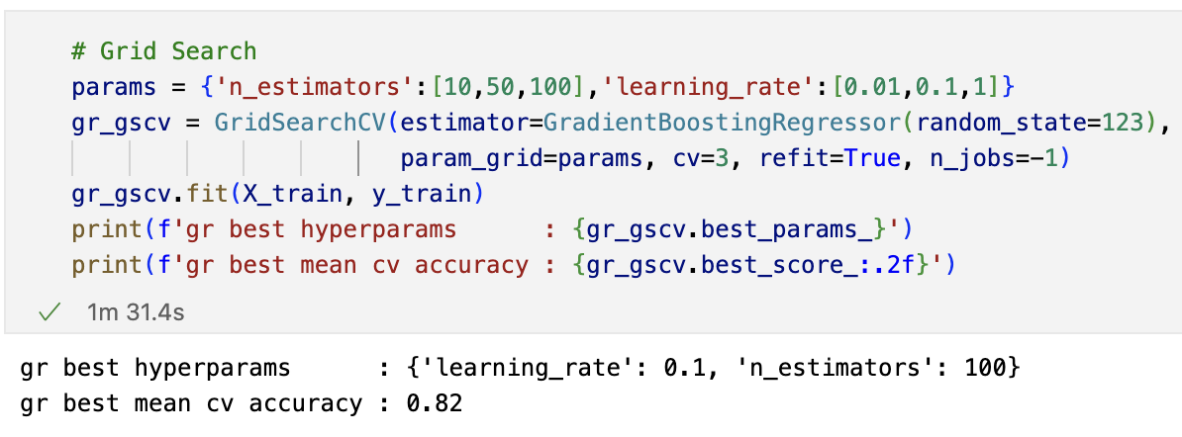
Machine Learning: Gradient Boost
Gradient Boost Regressor
Hyperparameter Tuning and Best Model Selection
Model Performance:
The best learning rate = 0.1
The optimal n estimators = 100
Best Model Performance:
Training score: 0.8254
MSE: 81.6608

Slide 38

Machine Learning: Gradient Boost
Gradient Boost Regressor - Feature Importance
Feature Importances:
('year', 0.9891290250186039),
('duration_ms', 0.001983907069081938),
('loudness', 0.0018745940843747676),
('acousticness', 0.0013931947691998496),
('instrumentalness', 0.0013718304785855248),
('speechiness', 0.0012971578025173917),
('liveness', 0.0011978459273449314),
('danceability', 0.0010141338359043433),
('energy', 0.0004281651086814007),
('explicit_1', 0.00010188195441835634),
('valence', 7.239236318631966e-05),
('explicit_0', 4.9889088651247526e-05),
('tempo', 4.977244604196847e-05),
('mode_0', 2.2183807538233905e-05),
('mode_1', 1.4026245869601496e-05)
Top 5 Features

Slide 39
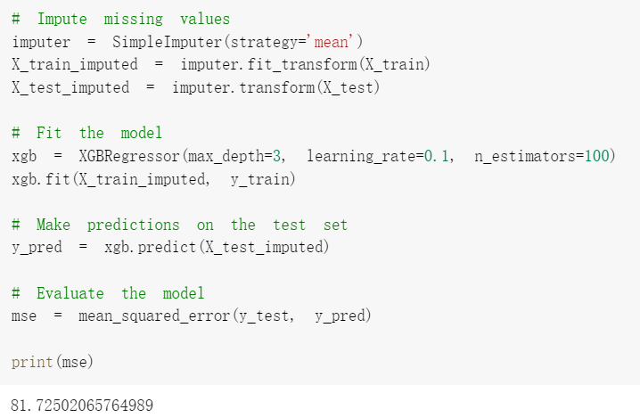
Machine Learning: Xgboost
Gradient Boost Regressor
Hyperparameter Tuning and Best Model Selection
Model Performance:
The best learning rate = 0.1
Max_depth = 3
The optimal n estimators = 100
Best Model Performance:
Training score: 0.83
MSE: 81.7250

Slide 40
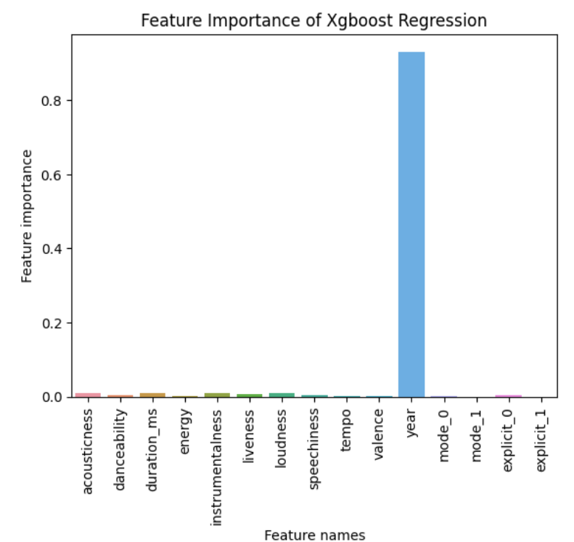
Machine Learning: XgBoost
XgBoost Regressor - Feature Importance
Feature Importances:
('year', 0.93086195),
('loudness', 0.010514024),
('acousticness', 0.009820845),
('instrumentalness', 0.009517046),
('duration_ms', 0.009120449),
('liveness', 0.0070600067),
('danceability', 0.005774328),
('explicit_0', 0.0051405346),
('speechiness', 0.0047789575),
('energy', 0.0031560701),
('valence', 0.0016335753),
('mode_0', 0.0016307181),
('tempo', 0.000991506),
('mode_1', 0.0),
('explicit_1', 0.0)

Slide 41
Conclusion: Model Comparison
 | Linear Regression | Decision Tree | Random Forest | SVM | AdaBoost | Gradient Boost | XgBoost
Classification (Accuracy Score） | - | 0.87 | 0.97 | 0.86 | 0.91 | 0.91 | -
Regression（MSE) | 100.69 | 82.70 | 82.00 | 103.80 | 88.51 | 81.66 | 81.73
Random Forest has the best performance in Classification
Gradient Boost has the best performance in Regression
Random Forest is an ensemble model using bagging method, Gradient is also an ensemble model using boosting method, which both help to lower the variance and lower the probability of overfitting of the model

Slide 42
Feature Selection
Univariate Tests
SelectKBest: ['acousticness', 'energy', 'year']
We find that year is the most influential feature in all the machine learning models we applied
Acousticness, Loudness, and Danceability are important feature we should pay attention to when predicting the popularity of a new song
Feature Importance from Model
 | Linear Regression | Decision Tree | Random Forest | SVM | AdaBoost | Gradient Boost | XgBoost
Classification | - | Year Loudness Duration | Year Loudness Speechiness | Year Danceability Acousticness | Year Acousticness Danceability | Year Loudness Duration | -
Regression | Year Acousticness Speechiness | Year Loudness Explicit | Year Acousticness Energy | Year Acousticness Speechiness | Year Instrumentalness Acousticness | Year Duration Loudness | Year Loudness Acousticness

Slide 43
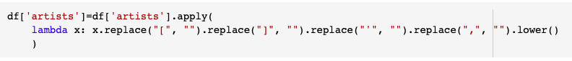
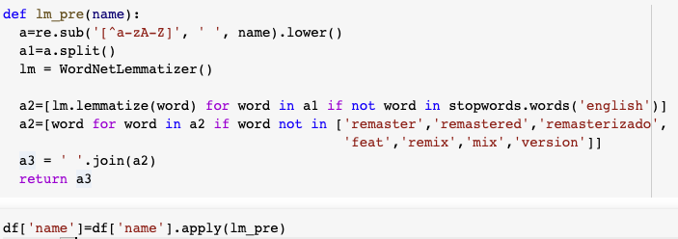
NLP: Text Features: ‘artists’, ‘name’
Preprocessing
Notes:
Remove punctuation, special characters, stop words and spaces -> lemmatized word.

Slide 44
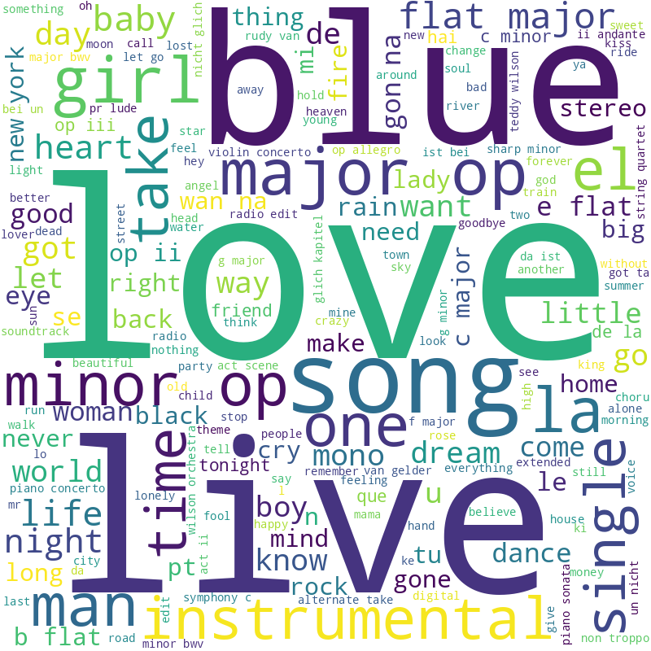

NLP: Word Cloud
Word Cloud of song name
Word Cloud of Artist

Slide 45

Content-based filtering recommendation system
TF-IDF transformation (column ‘artists’)
PCA dimension reduction
Similarity Matrix (cosine_similarity(df_scaled))
Recommendation Function: input an index of a song -> get top ten recommendation songs

Slide 46

K-means Clustering
Used elbow method;
n_cluster=4;
silhouette_score=0.553

Slide 47
K-means Clustering
Check on the mean of the X variables of each clusters:
cluster | counts | acousticness | danceability | duration_ms | energy | explicit | Instrumental- ness
0 | 60607 | 0.361428 | 0.542781 | 2.792041e+05 | 0.555768 | 0.099444 | 0.129972
1 | 8734 | 0.556893 | 0.427892 | 5.198750e+05 | 0.417558 | 0.023929 | 0.345756
2 | 100004 | 0.566147 | 0.546030 | 1.708483e+05 | 0.455100 | 0.081777 | 0.163641
3 | 564 | 0.736788 | 0.350738 | 1.365547e+06 | 0.308810 | 0.008865 | 0.448182

Slide 48
K-means Clustering
Check on the mean of the X variables of each clusters (cont.):
cluster | key | liveness | loudness | mode | speechiness | tempo | valence | year
0 | 5.204168 | 0.203747 | -10.385591 | 0.677183 | 0.081153 | 117.845023 | 0.491251 | 1986.56102
1 | 5.148157 | 0.240370 | -14.025472 | 0.652507 | 0.087403 | 112.191172 | 0.371329 | 1970.03298
2 | 5.203572 | 0.205133 | -11.705472 | 0.732551 | 0.101996 | 116.896174 | 0.572541 | 1972.29161
3 | 5.078014 | 0.277517 | -16.635665 | 0.693262 | 0.176325 | 103.412475 | 0.239232 | 1959.57447

Slide 49


K-means Clustering: Word Cloud
First the word cloud of each cluster are different in some aspect.
Word Cloud of Cluster 0
Word Cloud of Cluster 1

Slide 50


K-means Clustering: Word Cloud
Word Cloud of Cluster 2
Word Cloud of Cluster 3

Slide 51
K-means Clustering - Cluster 0&2
Common: Music from these two clusters both have high valence, explicit, tempo and danceability values, meanwhile have low instrumentalness values;
Difference: The year of produce of music from cluster 0 are latter than the ones from cluster 2;
According to the word cloud from previous slide, we can conclude that cluster 0 and cluster 2 share the common features below:
Having the attribute of “live”, “feat”, and “blue”, music in these two clusters have a strong and instrumental rhythm, which are obvious in melody;
The scene of music are concentrate on “dream”, “holiday”, “romance”, giving a feeling of relax, happiness, cozy etc.

Slide 52
K-means Clustering - Cluster 1
Music in cluster 1 are more likely released in 1970s;
Background information about 1970s:
“The Seventies was the decade of the super long song. While the 50s and 60s was spent honing the short, tight, radio friendly pop song, the 1970s saw bands exploring concept albums, concept tracks, more free form styles and longer storytelling and in the process creating some very long songs indeed.”
Music in cluster 1 tend to have a longer duration and a larger amount of words and lyrics;
The total number of songs in cluster 1 is less than 1000.
We conclude that the music of cluster 1 are mostly long storytelling music, or mix of music collections.

Slide 53
K-means Clustering - Cluster 3
There are not so much music in cluster 3;
The music of cluster 3 are mostly order music with high instrumentalness that are gentle and light music;
We conclude that most of the music in cluster 3 is pure music, such as Bach's piano pieces.

Slide 54


Discussion
The genre and artists’ popularity of the songs are
missing in the data set.
For factor Mode, there should be 8 modes in total according to our research, but it’s included as a dummy variable in the data set.
And sometimes, whether the song is popular also has a certain luck factor. Sometimes it does happen that some songs just becomes a big hit by chance.
The dataset we used focus on the attributes of music.
User-based dataset may perform better in music categorization and
recommendation.

Slide 55
References
• Negi, E. (2020) Spotify-data 1921-2020, Kaggle. Available at: https://www.kaggle.com/datasets/ektanegi/spotifydata-19212020
• James, Gareth et al. An Introduction To Statistical Learning. 2nd ed., Springer, 2021.
• "Mode | Music", Encyclopedia Britannica, 2022,
https://www.britannica.com/art/mode-music
• "Random Forests - Classification Description". Stat. Berkeley.Edu, 2022,
https:// www.stat.berkeley.edu/~breiman/RandomForests/cc_home.htm
• Venetia. “The Long and the Short of It.” Living in the 70s, 9 July 2021, joy.org.au/livinginthe70s/2021/07/10/very-long-and-very-short-songs/

